Slide 1
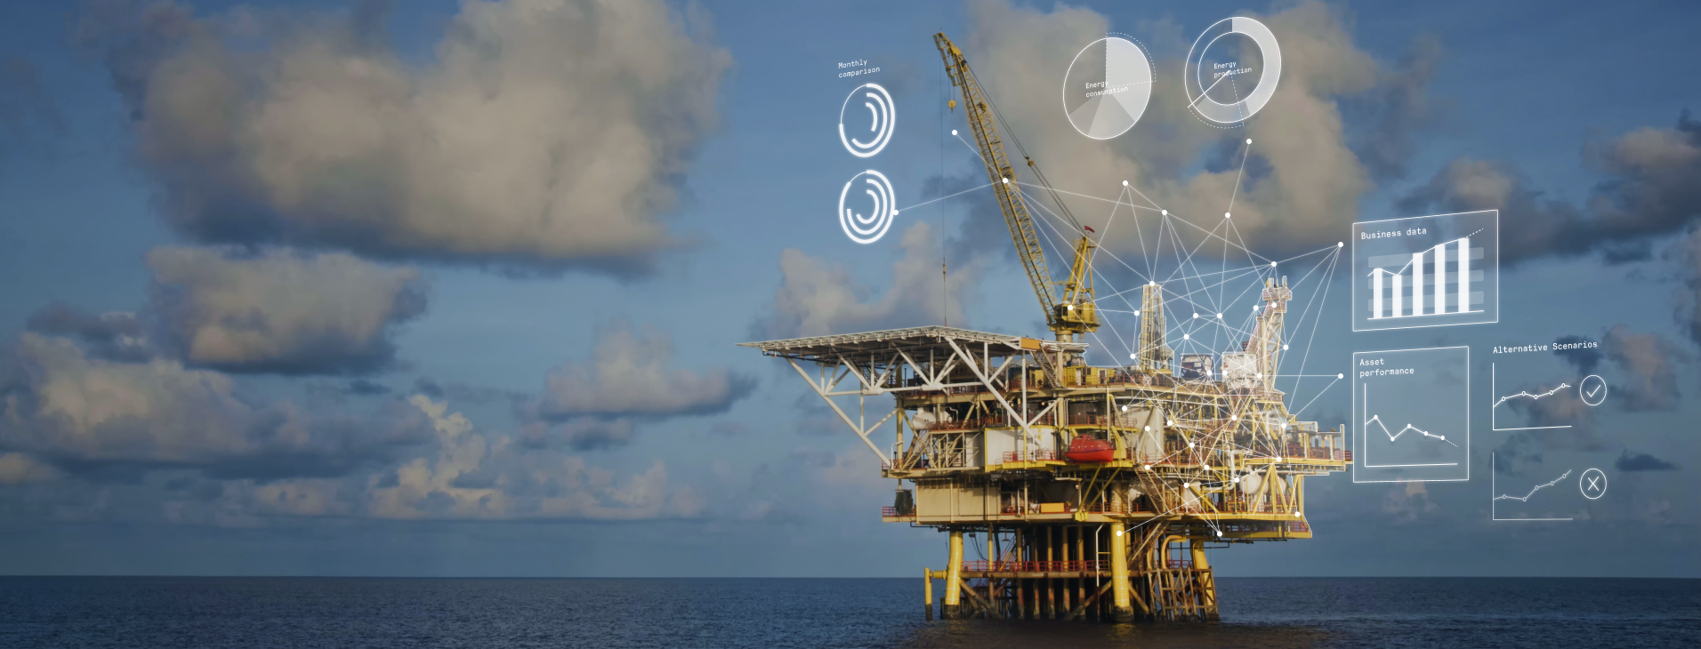
What If you could…
operate your assets more sustainably and safely
attract and retaining talent
reduce your OPEX
Notes:
What if you could
operate your assets more sustainably and safely,
attract and retain talent by providing a responsive, immersive and purposeful environment
reduce your opex?

Slide 2
30,000
Notes:
How about returning 30,000 hours labor hours to the business in a year?

Slide 3
What can digital twins do to improve performance on existing upstream assets?
Haavard Oestensen
Vice President of Growth
Kongsberg Digital
Notes:
My name is Haavard Oestensen, and I am with Kongsberg digital. We digitalize the world’s industries, for better performance today and a better tomorrow. I am here to talk about how digital twins can help improve performance and improve the operating model that supports your upstream assets.

Slide 4
What are our options?
Options
Return
Decommission & destroy
Little to none
Operate at minimum
Invest to improve existing infrastructure
High Capex outlay – prohibitive
New paradigm for structured financing
Digital Twin Powered Operating Model
Integrating capabilities like digital collaboration, integrated workflows and scalable simulation and analytics allow operators to increase operating efficiencies and lower costs in a greener, safer way.
Sources: KONGSBERG internal research, McKinsey & Company, customer interviews
Notes:
First, let’s consider our options at a high level. If we look at the challenge from a conventional point of view, we can
Decommission and destroy facilities that don’t perform, but we probably won’t do that
We can operate them at a minimum, or business as usual – at a return dictated by the commodity prices – or at the mercy of rising input prices
Then - We can invest to improve the infrastructure, i.e.
tiebacks to existing platforms
debottlenecking projects
subsea compression, and so on – could work,
However, with these options we are operating at the mercy of volatile commodity and input prices
Then, in relative terms a much lower cost investment would be digital. So allow me to introduce the digital twin powered operating model:
Digital collaboration
Integrated business processes with remote operations
Leveraging scalable simulation and analytics to drive performance
Together, this lets operators increase operating efficiencies, lower costs and improve ways of working.

Slide 5
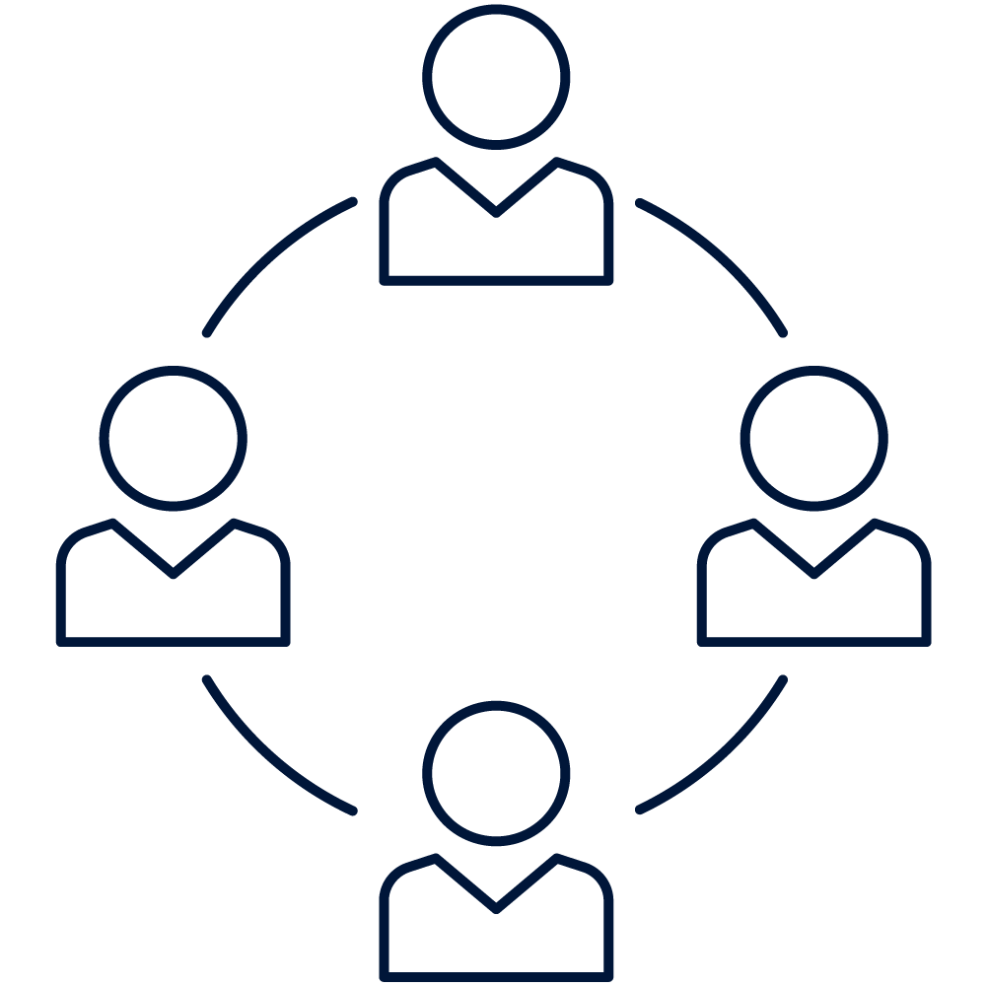
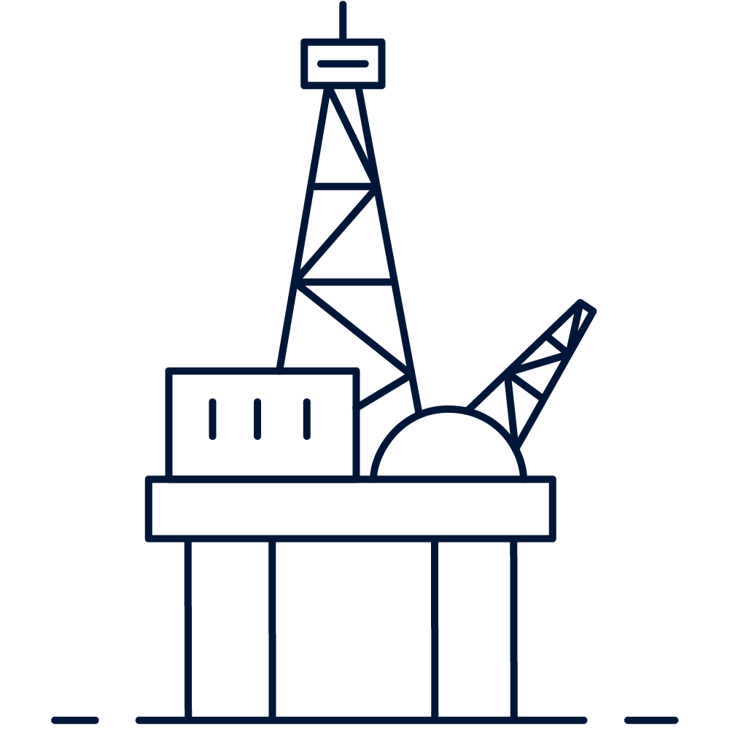
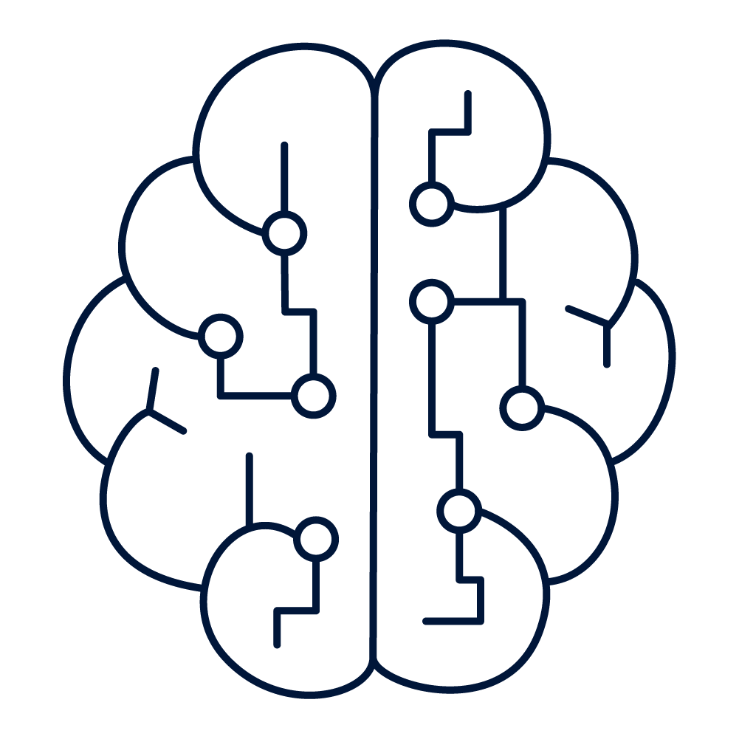
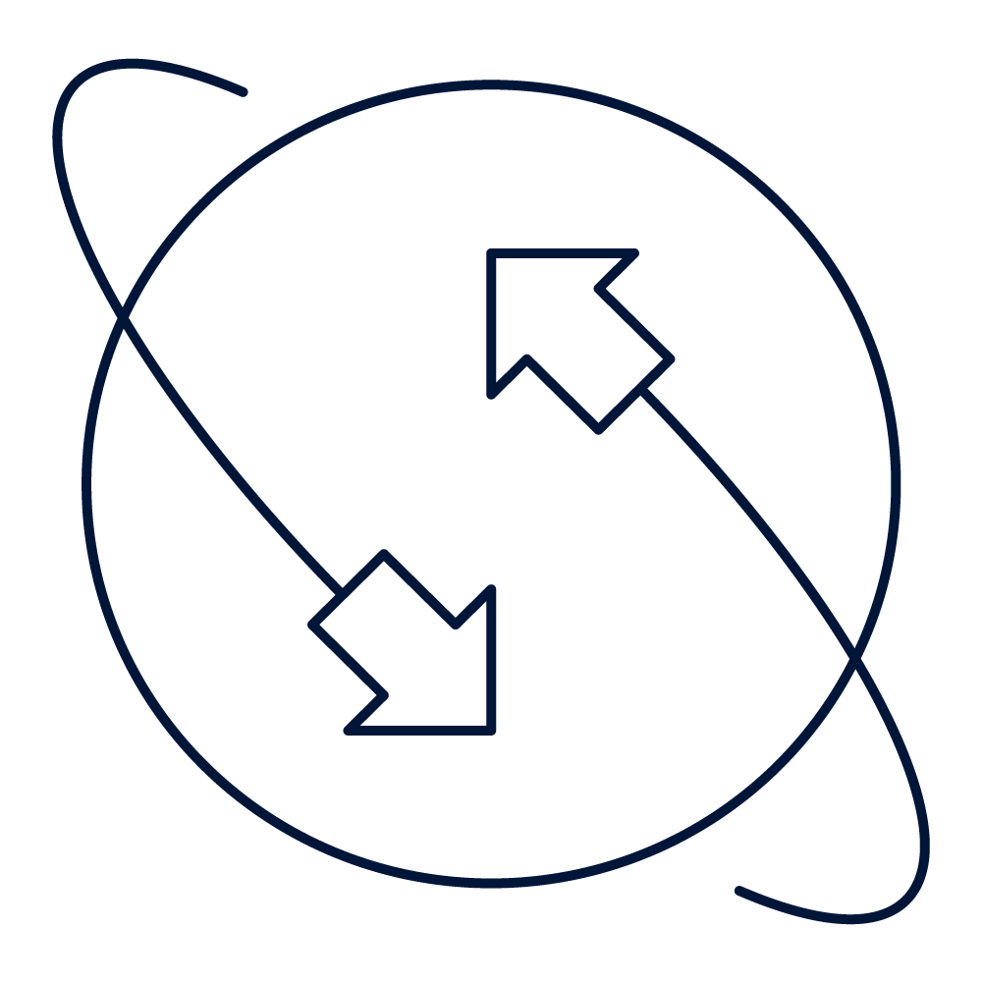
We are deeply engaged in helping operators tackle the biggest challenges of the industry
Utilization of existing infrastructure
Capital investments into brownfield projects are increasingly focused on maximizing utilization of existing physical facilities, and improving sustainability
Remote & Semi-Autonomous Operations, across fleets of assets
Reduce operating costs sustainably
Relocate technical support teams from site, whilst increasing operational efficiency. Couple energy efficiency with throughput and performance.
Rework the legacy operating models to become leaner and greener
Reduce dependency on personnel onsite; enabling more streamlined and digital operating models – tapping ecosystems of expertise
Underpinning Capabilities
Meaningfully embed sustainability in operations
Deliberately focus on emissions reduction, energy management and transparency
Efficiency
(Semi)-Autonomous
Value Chain Integration
Collaborative ways of working
Safety
Notes:
At KDI, we are deeply engaged in the biggest challenges in the industry. Our observation from working with the industry is that there is an emerging consensus on the top level items to handle.
Operators are looking to maximize utilization of existing facilities: Fewer topsides development and more tiebacks, subsea compression etc.
Reduce the operating costs, but sustainably. We help with energy consumption optimization coupled with production optimization to improve performance and make operations greener
We work on the operating model, reducing dependency on onsite personnel, enabling streamlined digitally enabled operating models,
Lastly, we help meaningfully embedding sustainability into operations. Specifically, digital twins help with emissions reduction, energy management and transparency
The result is a redefined operating model that is more efficient and sustainable, more reliance on remote support and expertise, with safety, performance and sustainability at the core.

Slide 6
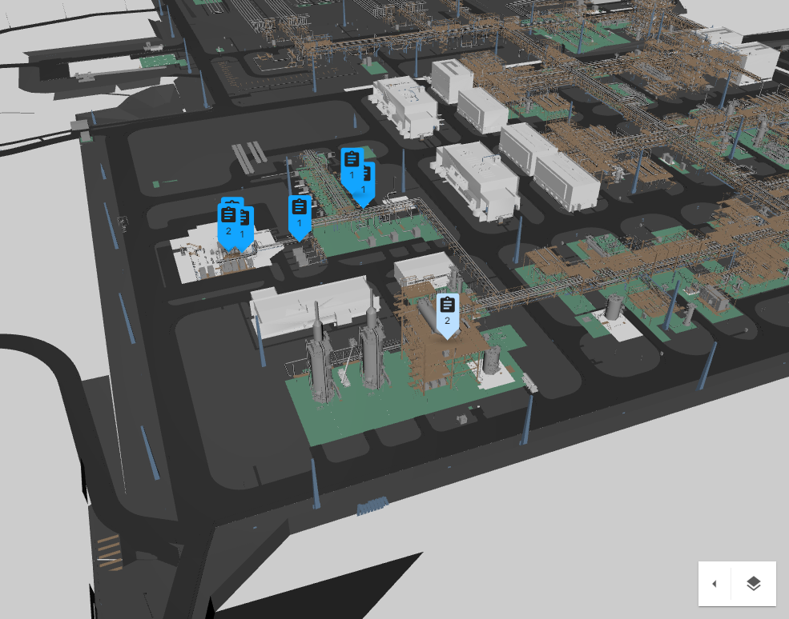
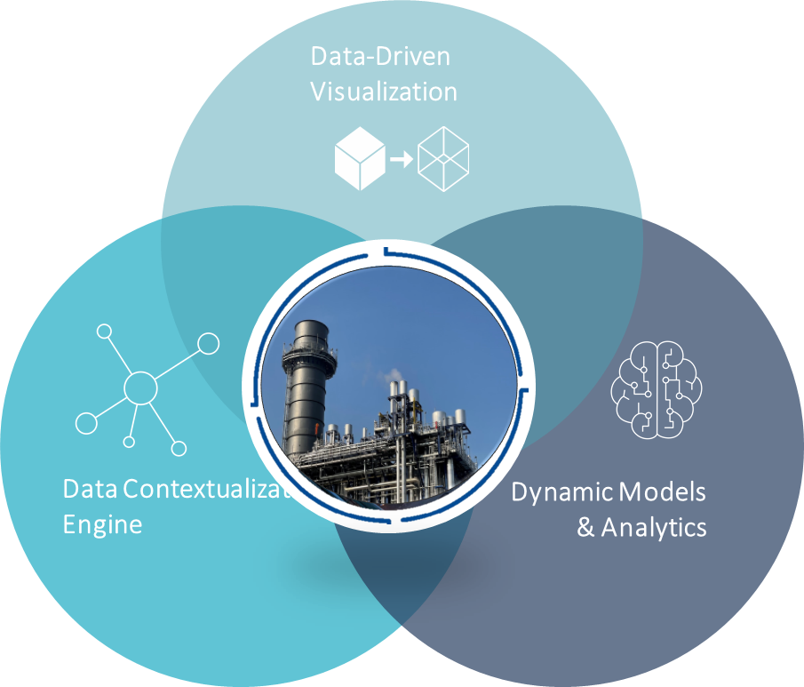
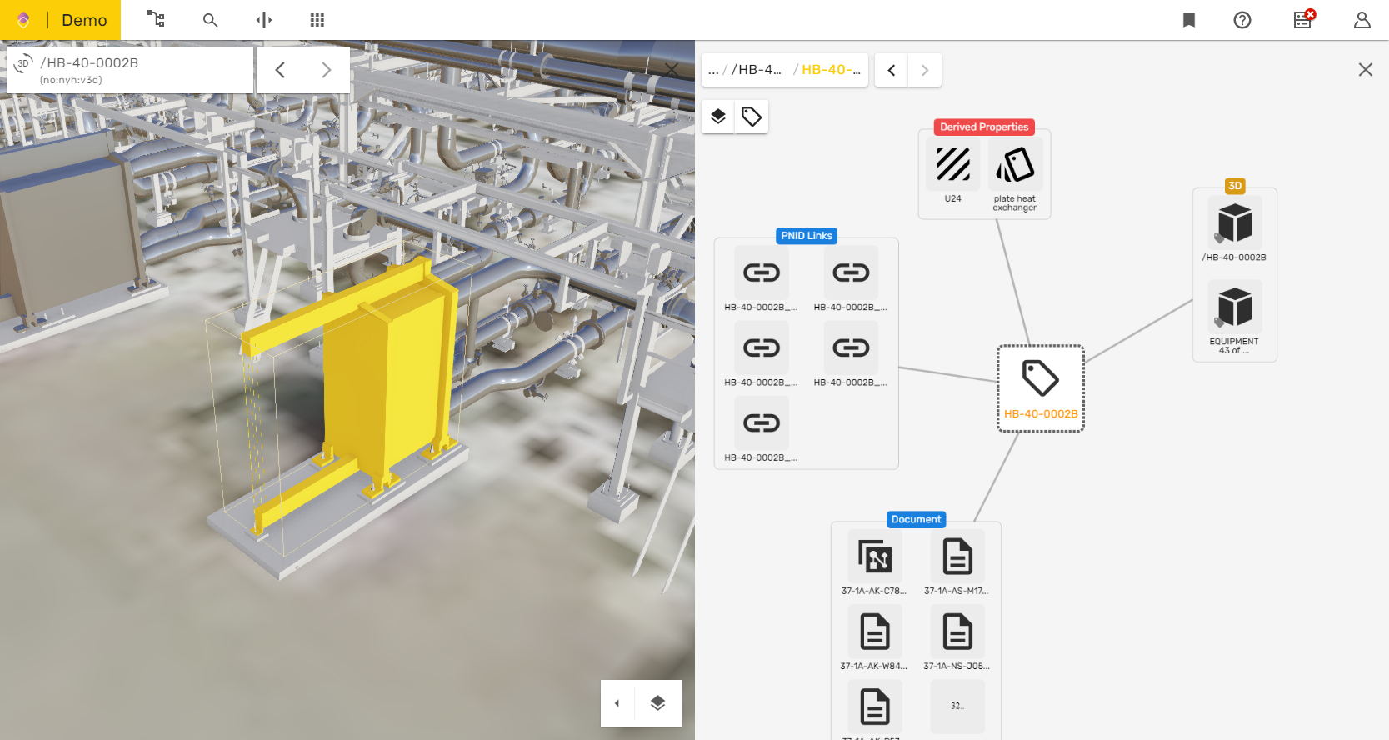
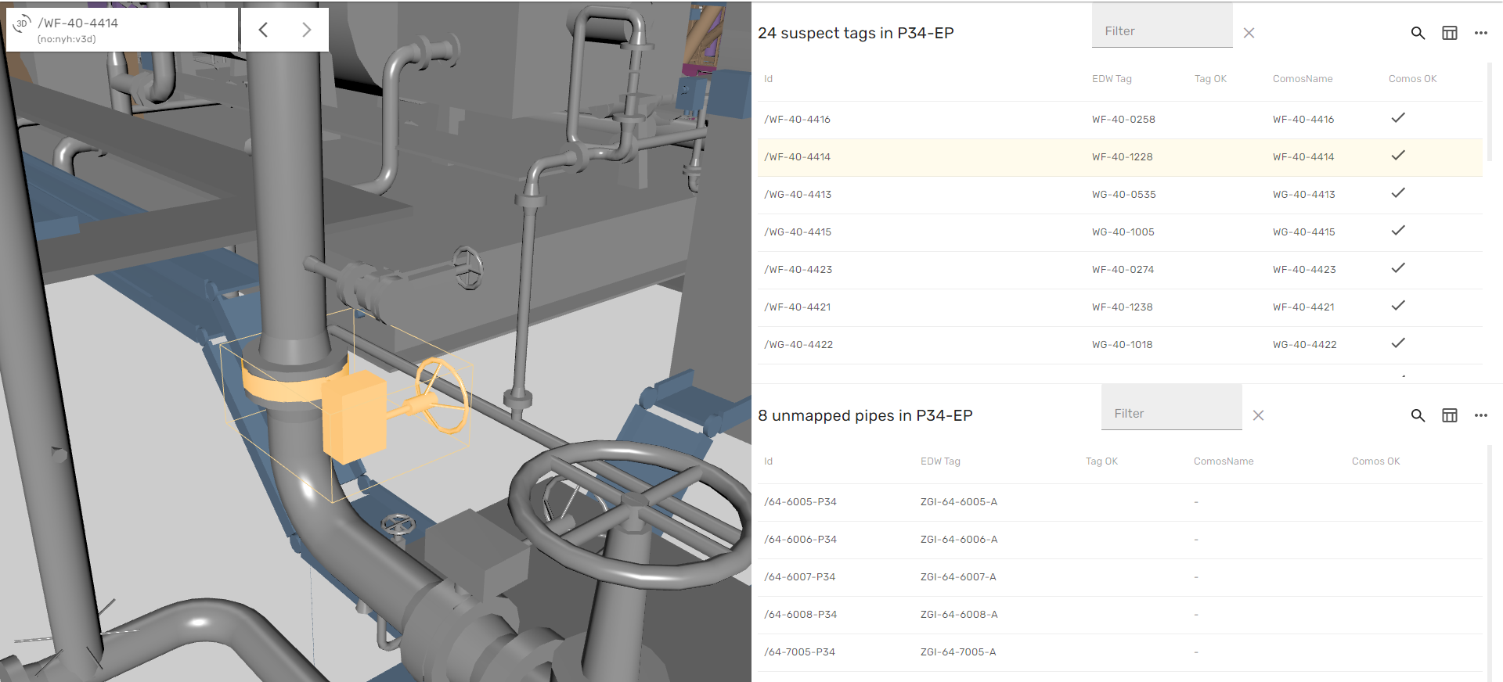
Digital twin is a virtual and dynamic representation of a full-scale energy asset
Enabling the future of asset operations
Reimagine how you work, while improving team and asset performance. With intuitive access to all of your data, you can orchestrate your end-to-end asset-related workflows across all your data, with simplified collaboration throughout the organization.
Kognitwin™ Energy a dynamic digital replica of your facility
T-42-0001 - Methanol
Notes:
A digital twin, as we term it, is one environment that everyone in the organization uses. It has
Industrial data from all of your systems available
Intuitive 3D and 2D visualization and workflows
Embedded simulation and analytics capabilities

Slide 7
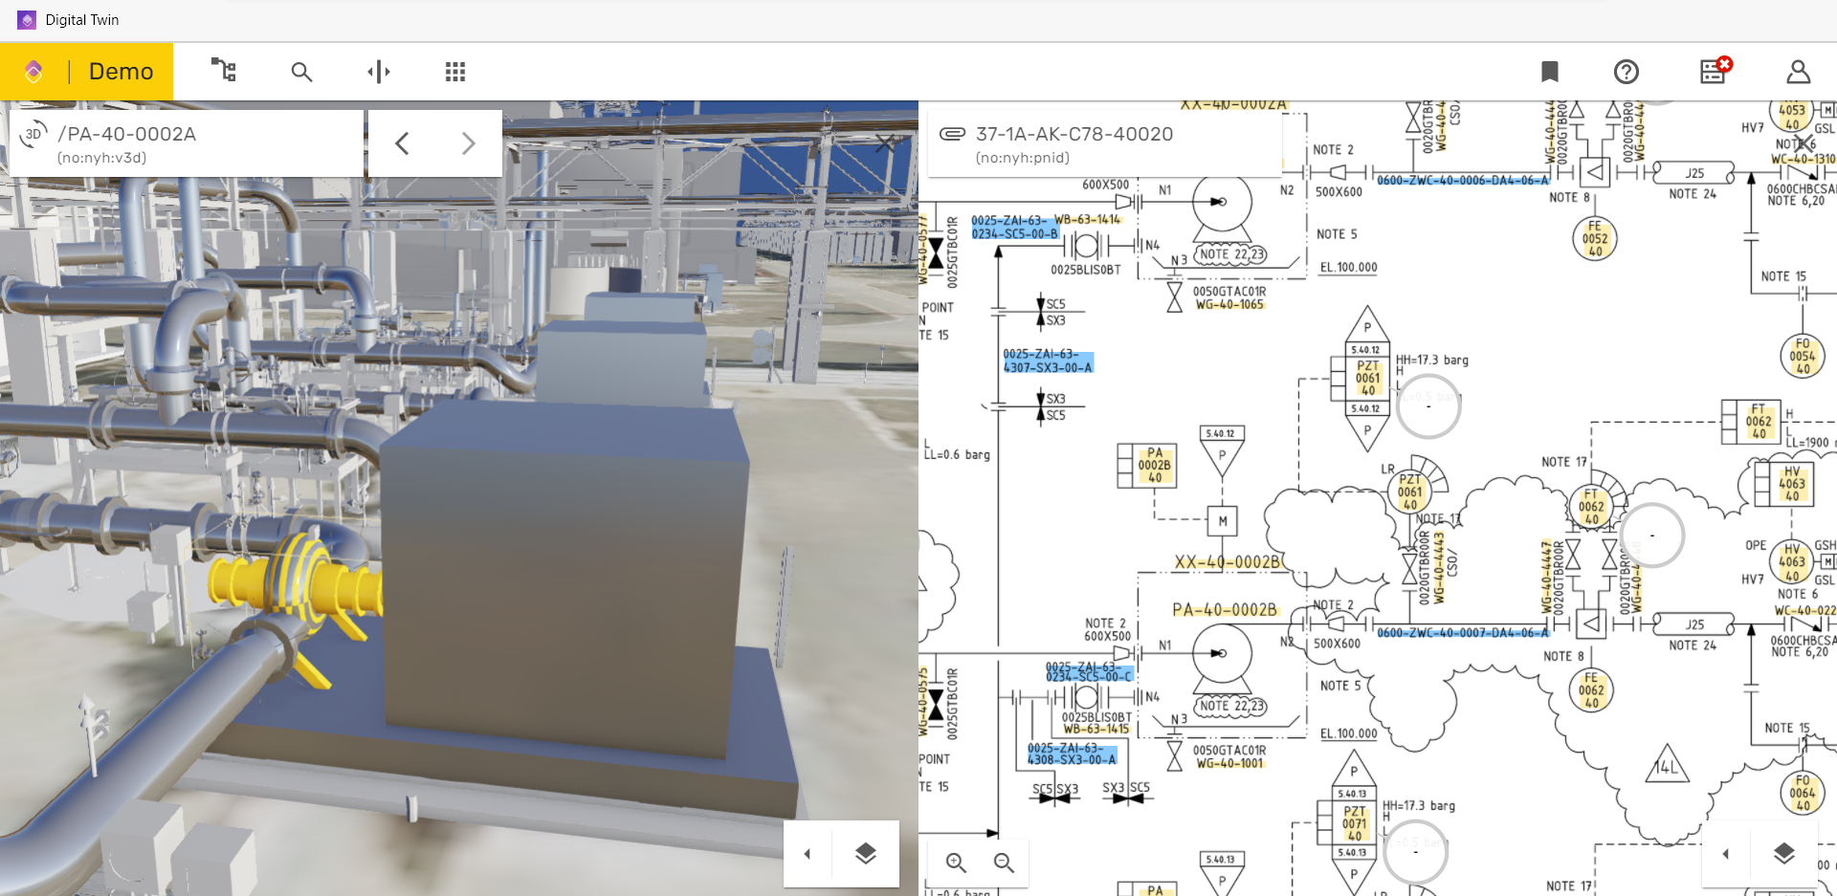
The digital work surface
Contextualized Tools & Data
Always On Simulation + DCS Data
Notes:
Let’s take a tour of what is looks like.
Visualization – an intuitive and high-fidelity model of the reality; this has to be easy to use, immersive and responsive. Accuracy down to the millimeter, and complete with access to all your data through this interface.
Critically, as we have observed, 3D is not sufficient to mobilize the workforce at full scale
2D P&ID is a common interface, that makes it “less scary” to start working digitally. How does one do that
Well, we take the experience today (P&ID) and enrich it will ALL the data that engineers use. Real-time feeds from DCS, simulation, analytics, ERP and historians – all in one place. And we make it as EASY to use as possible.
The engineers actually like not having to access 10+ systems on a day to day basis. In the software business, we call this “user adoption”.
This is underpinned by a complete dataset that represents your underlying set of systems, some time sin the dozens, sometimes more than a hundred. We construct an accessible data model that can be navigated easily, and workflows can be built on top of this data.

Slide 8
Contextualized Tools & Data
Always On Simulation + DCS Data
Notes:
Let’s take a tour of what is looks like.
Visualization – an intuitive and high-fidelity model of the reality; this has to be easy to use, immersive and responsive. Accuracy down to the millimeter, and complete with access to all your data through this interface.
Critically, as we have observed, 3D is not sufficient to mobilize the workforce at full scale
2D P&ID is a common interface, that makes it “less scary” to start working digitally. How does one do that
Well, we take the experience today (P&ID) and enrich it will ALL the data that engineers use. Real-time feeds from DCS, simulation, analytics, ERP and historians – all in one place. And we make it as EASY to use as possible.
The engineers actually like not having to access 10+ systems on a day to day basis. In the software business, we call this “user adoption”.
This is underpinned by a complete dataset that represents your underlying set of systems, some time sin the dozens, sometimes more than a hundred. We construct an accessible data model that can be navigated easily, and workflows can be built on top of this data.

Slide 9
Contextualized Tools & Data
Always On Simulation + DCS Data
Notes:
Let’s take a tour of what is looks like.
Visualization – an intuitive and high-fidelity model of the reality; this has to be easy to use, immersive and responsive. Accuracy down to the millimeter, and complete with access to all your data through this interface.
Critically, as we have observed, 3D is not sufficient to mobilize the workforce at full scale
2D P&ID is a common interface, that makes it “less scary” to start working digitally. How does one do that
Well, we take the experience today (P&ID) and enrich it will ALL the data that engineers use. Real-time feeds from DCS, simulation, analytics, ERP and historians – all in one place. And we make it as EASY to use as possible.
The engineers actually like not having to access 10+ systems on a day to day basis.
This is underpinned by a complete dataset that represents your underlying set of systems, some time sin the dozens, sometimes more than a hundred. We construct an accessible data model that can be navigated easily, and workflows can be built on top of this data.

Slide 10
Contextualized Tools & Data
Always On Simulation + DCS Data
Notes:
Let’s take a tour of what is looks like.
Visualization – an intuitive and high-fidelity model of the reality; this has to be easy to use, immersive and responsive. Accuracy down to the millimeter, and complete with access to all your data through this interface.
Critically, as we have observed, 3D is not sufficient to mobilize the workforce at full scale
2D P&ID is a common interface, that makes it “less scary” to start working digitally. How does one do that
Well, we take the experience today (P&ID) and enrich it will ALL the data that engineers use. Real-time feeds from DCS, simulation, analytics, ERP and historians – all in one place. And we make it as EASY to use as possible.
The engineers actually like not having to access 10+ systems on a day to day basis. In the software business, we call this “user adoption”.
This is underpinned by a complete dataset that represents your underlying set of systems, some time sin the dozens, sometimes more than a hundred. We construct an accessible data model that can be navigated easily, and workflows can be built on top of this data.

Slide 11
Contextualized Tools & Data
Always On Simulation + DCS Data
Notes:
Let’s take a tour of what is looks like.
Visualization – an intuitive and high-fidelity model of the reality; this has to be easy to use, immersive and responsive. Accuracy down to the millimeter, and complete with access to all your data through this interface.
Critically, as we have observed, 3D is not sufficient to mobilize the workforce at full scale
2D P&ID is a common interface, that makes it “less scary” to start working digitally. How does one do that
Well, we take the experience today (P&ID) and enrich it will ALL the data that engineers use. Real-time feeds from DCS, simulation, analytics, ERP and historians – all in one place. And we make it as EASY to use as possible.
The engineers actually like not having to access 10+ systems on a day to day basis. In the software business, we call this “user adoption”.
This is underpinned by a complete dataset that represents your underlying set of systems, some time sin the dozens, sometimes more than a hundred. We construct an accessible data model that can be navigated easily, and workflows can be built on top of this data.

Slide 12
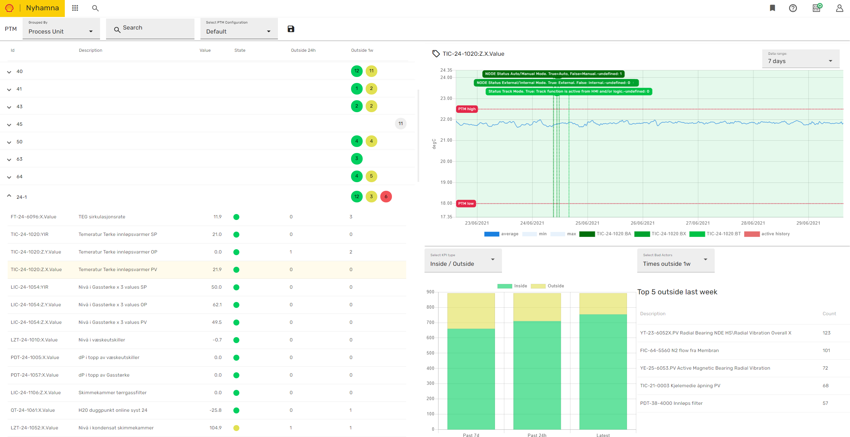
Contextualized Tools & Data
Always On Simulation + DCS Data
Notes:
PTM
Proactive technical monitoring – PTM is one example
Engineers access data trends and the digital twin identifies which are they should focus on, with rulesets and notifications that are setup to trigger workflows.
Statistics on historical bad actors are supplied as well
This allows the engineers to focus their time on the most important issues; rather than wading through the data to determine what should have higher criticality.
Then they can navigate and collaborate in the digital twin to coordinate actions to be taken

Slide 13
Contextualized Tools & Data
Always On Simulation + DCS Data
Notes:
PTM
Proactive technical monitoring – PTM is one example
Engineers access data trends and the digital twin identifies which area they should focus on, with rulesets and notifications that are setup to trigger workflows.
Statistics on historical bad actors are supplied as well
This allows the engineers to focus their time on the most important issues; rather than wading through the data to determine what should have higher criticality.
Then they can navigate and collaborate in the digital twin to coordinate actions to be taken

Slide 14
Contextualized Tools & Data
Always On Simulation + DCS Data
Notes:
PTM
Proactive technical monitoring – PTM is one example
Engineers access data trends and the digital twin identifies which are they should focus on, with rulesets and notifications that are setup to trigger workflows.
Statistics on historical bad actors are supplied as well
This allows the engineers to focus their time on the most important issues; rather than wading through the data to determine what should have higher criticality.
Then they can navigate and collaborate in the digital twin to coordinate actions to be taken

Slide 15
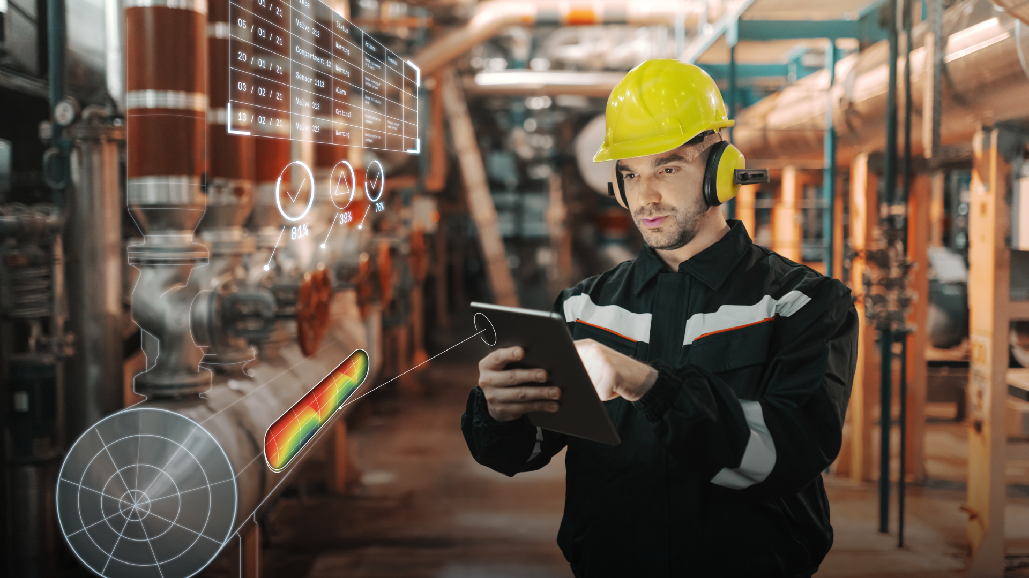
Contextualized Tools & Data
Always On Simulation + DCS Data
Notes:
Only when data and workflows like this converge into one environment and are used on a day-to-day basis, can you argue that you are making a change with a digital strategy. That gives meaning to this fancy marketing picture.

Slide 16
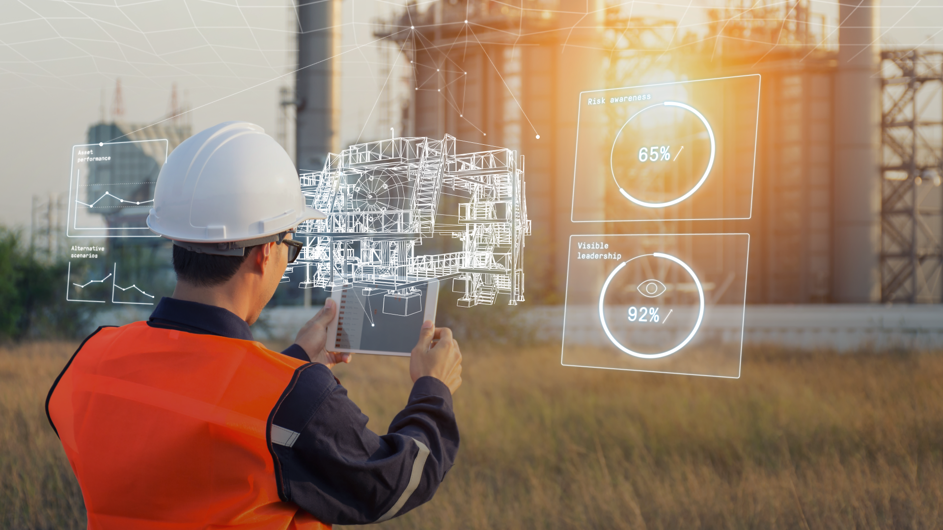
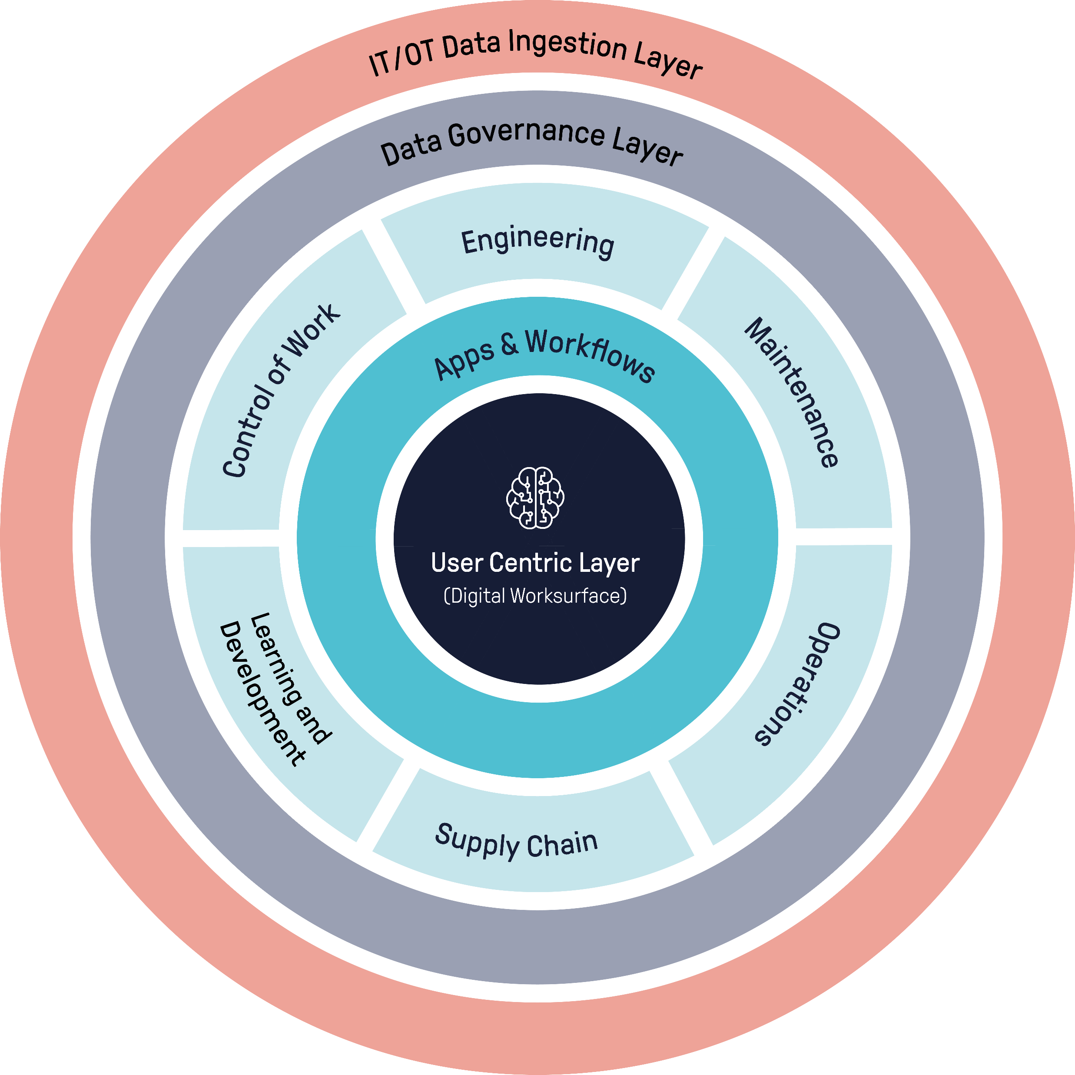
Kognitwin® Your Industrial Work Surface
Asset Management Process layer
Reimagine how you work
Notes:
So in essence we then have the industrial work surface, the one environment that drives the business processes, engagement and analytics. The human is at the center.
Critically, this system must touch on ALL the disciplines to enable digital success.

Slide 17
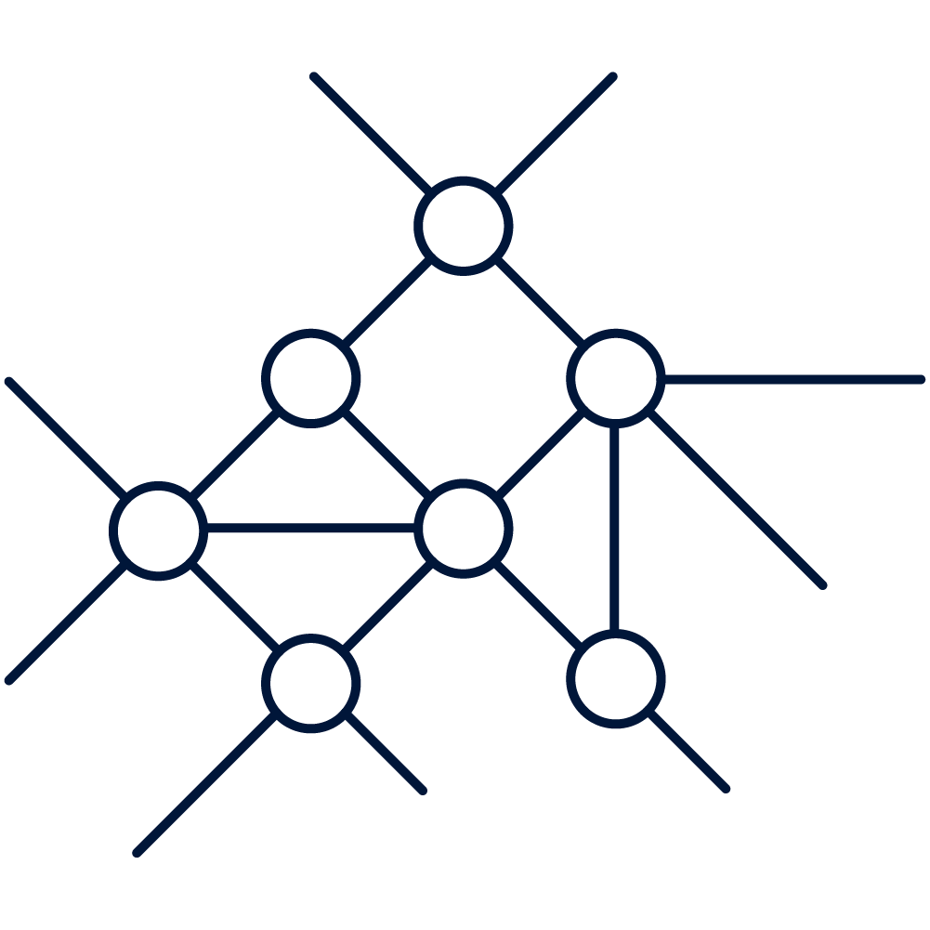
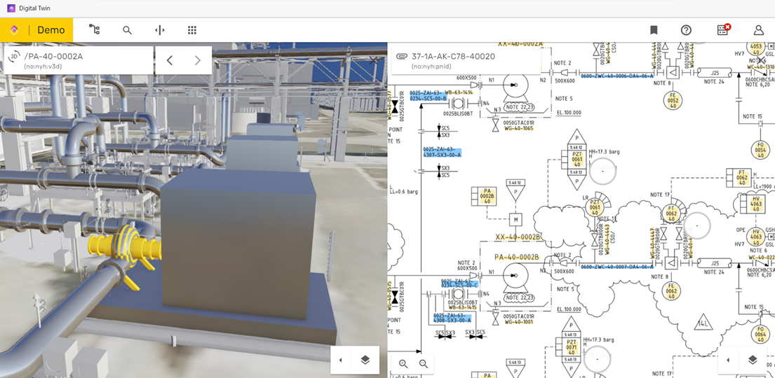
The industrial work surface enables upstream companies in improving their operating models
Key Areas of Focus
Kognitwin® Industrial Work Surface
Improved Operating Model
Centralized teams manage many assets, with higher efficiency
True business process integration – Closing the loop
Asset Management Process layer
3rd party integrations and interoperable ecosystems
Connectivity and analytics across asset portfolios
scalable analytics integrations through partnerships
Demand from the assets drives organizational flexibility in the supporting teams, whether they are onsite, offsite in integrated ops centers or remote. Experts address issues across a portfolio of assets, enabling leaner, more efficient and data-driven teams
Invoke external asset service models
17
Notes:
Looking at the operating model, I will state 3 strategic focus areas
Focus on true business process integration. How is it true, by closing the loop. That’s what we are working on today
Then, we are not monolithic. The industry has realized, and we agree, that this is team work, and progress is not well-served by software monoliths. That’s why we focus on openness and interoperability in our strategy, so operators can pick for example the data science partners they want.
And lastly it must be really easy to setup and scale connectivity. We invest a lot in this 8-12 weeks for an asset is now a reality.
When we do all this, we enable that new operating model that scale across fleets of assets, in a remote operating environment.

Slide 18
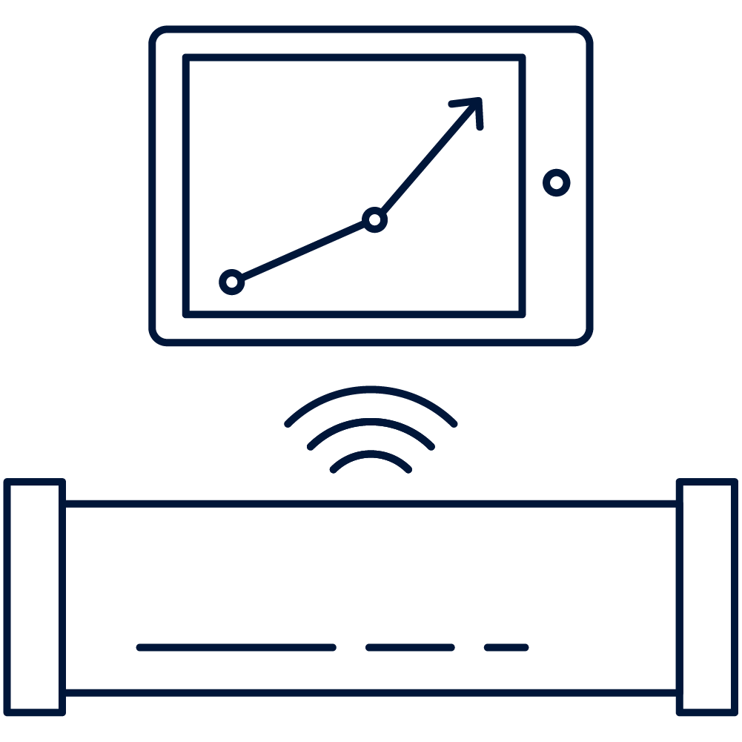
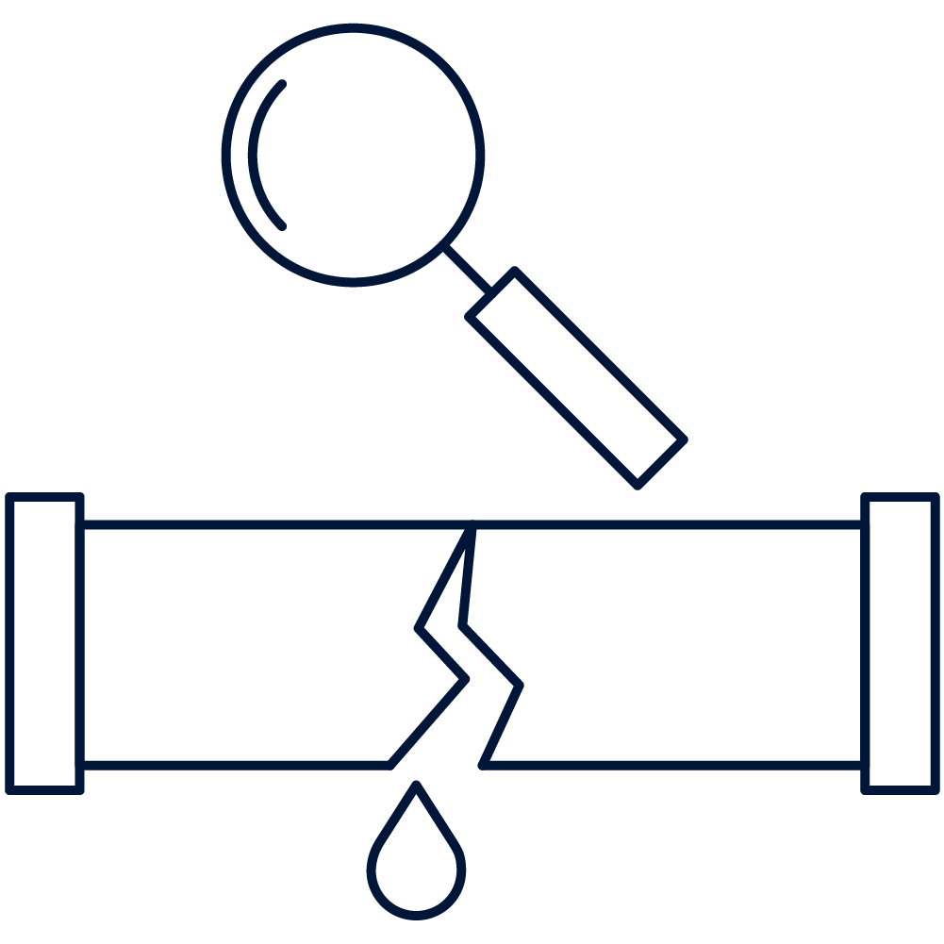
Introduction of the digital twin as the industrial work surfaces yields results
Improvement Areas
Material OPEX gains
Production and Energy Efficiency
25k
worker hours reduced (up to 30k on complex upstream setups)
Maintenance Planning & Execution
2%
Up to 2% O&M spend savings
End-to-end optimization
0.3%
Up to 0.3% production increase
1.5%
1-1.5% energy consumption reduction
Data-driven ways of working
$3M
Savings enabled for asset during initial 12- month service period
Sources: KONGSBERG internal research, McKinsey & Company, customer interviews
Notes:
As for the results, here are some examples. I’ll leave you to read some of these numbers yourself. However, I will emphasize one thing:
Let’s not get hung up on the exactness of this; each asset has a different environment
These were achieved back in 2020 – 18 months ago.
The important thing is that when we implement this strategy, we see improvement in efficiencies across all these areas. This goes back to embedding digital meaningfully.
This is just the beginning; the actual gains have a much higher potential

Slide 19
From hype to reality: The digital twin discussion has moved forward
WHY?
HOW
2-3 years ago
now
Notes:
As someone representing the digital tech community, I am happy to report that we’ve moved forward. I have found myself in many meetings explaining WHY this is important, or listening patiently to how “we’ve already done this” or “what’s the value”.
Now, the conversation has moved from why to how. We have seen the industry achieve agreement in the sense that we are now operating on a call to action. As a result the conversations are about the how.

Slide 20
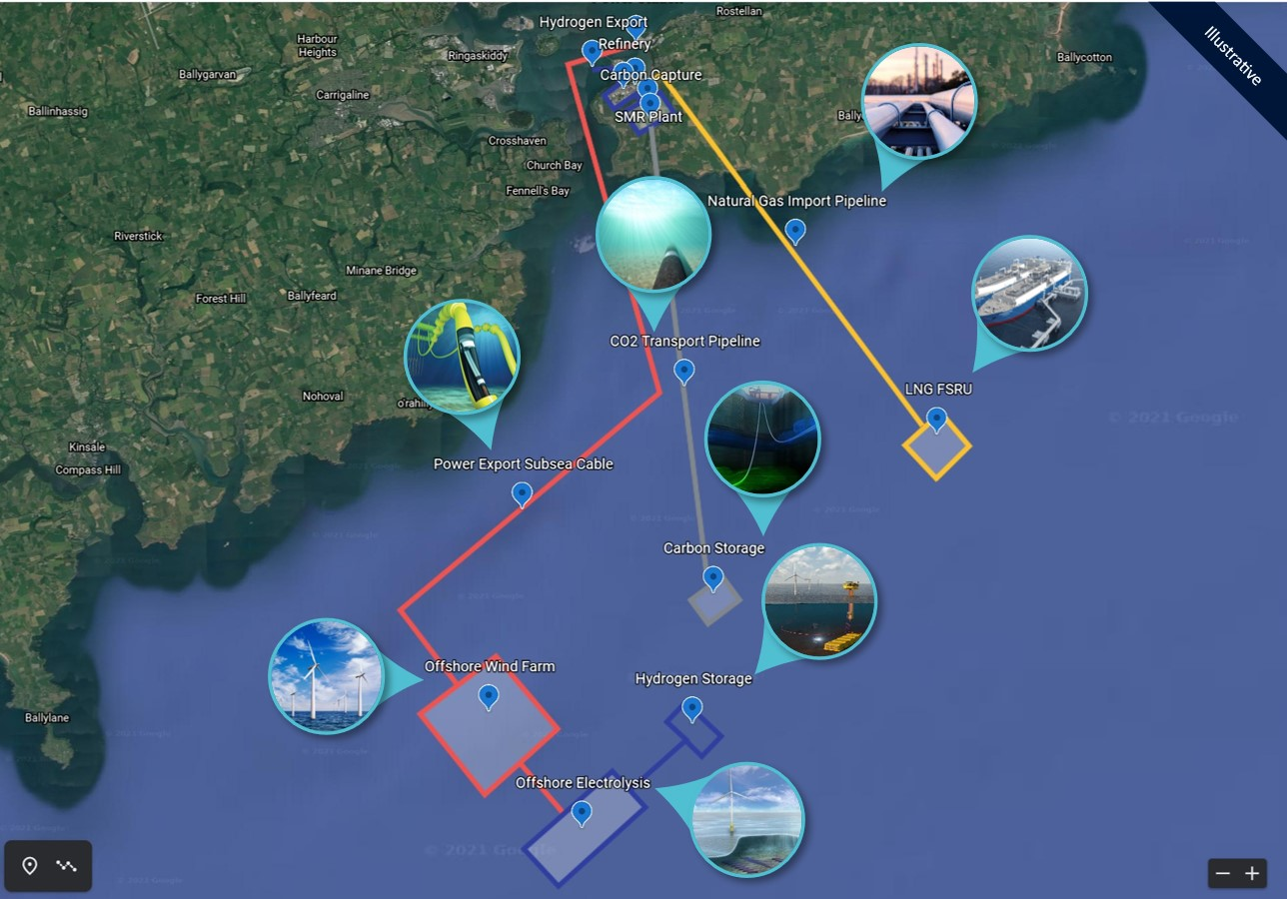
The future of energy systems is integration
Licence to operate
Capital investments into greenfield projects of the future will require a carbon neutral approach
Expanding the energy system
Integrating technology solutions with assets such as hydrogen, CCS⁽¹⁾, wind, and microgrids is likely to be one standard part of an investment
Twin of Twins
Kognitwin is strongly positioned to provide an integrated twin for the proposed system
Industrial Worksurface
Provides a work surface to operate and maintain a complex fleet of assets
Collaborating at scale
Further enhance collaboration across increasingly complex operating assets
Source: Company information
Notes:
The last thing to note on is the future. AT KDI, we see that the future of energy systems is in the integration.
This is an example from offshore Ireland. What we see here is a complex setup of offshore wind, hydrogen, LNG import and gas back to onshore distribution. The common denominator is interdepencence; if one unit is impacted, the whole system is impacted.
The new skills that will be required to support energy systems like this will focus more on understanding and operating the interdependencies.
We believe that a digital infrastructure is essential to achieve this.

Slide 21
What If you could…
operate your assets more sustainably and safely
attract and retaining talent
reduce your OPEX
Notes:
In conclusion, and in the language of digital twins: this is no longer a “what if scenario”.
With digital twins, you can:
Operate your assets more sustainably and safely
You can attract and retain talent, offering a more responsive and purposeful work environment
Reduce your Opex

Slide 22
We are Kongsberg Digital
800+ EMPLOYEES
6 COUNTRIES
2022
32 Nationalities
3 Key Product Areas

